Slide 1
CRC Modeling

Slide 2

Class Responsibility Collaborator (CRC)
CRC (class responsibility collaborator) modeling process for identifying user requirements.
CRC modeling is an effective, low-tech method for developers and users to work closely together to identify and understand business requirements.
A CRC card is an index card that is used to represent the responsibilities of classes and the interaction between the classes.
CRC cards are an informal approach to object oriented modeling.
The cards are created from use-case scenarios, based on the system requirements.

Slide 3
The CRC card Session
Groups consisting of five or six people.
Each group typically consists of developers, domain experts and an
OO technology facilitator.

Slide 4
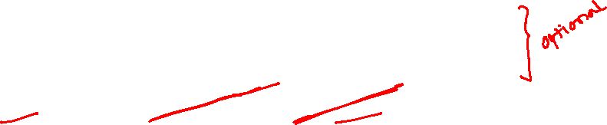
A CRC card
Class name:
SuperClasses:
SubClasses
Responsibility
Collaborator

Slide 5
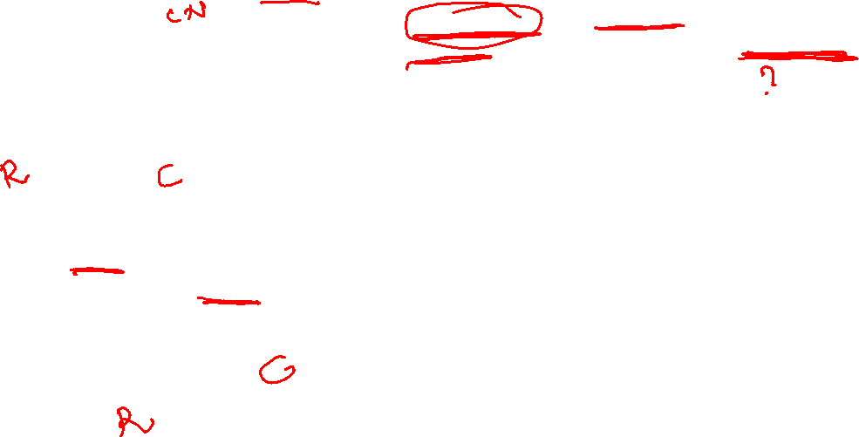

Slide 6

Class
A class represents a collection of similar objects. An object is a person, place, thing, event, concept, screen, or report that is relevant to the system at hand.
For example, a shipping/inventory control system with the classes such as Inventory Item, Order, Order Item, Customer, and Surface Address.
The name of the class appears across the top of the card.

Slide 7
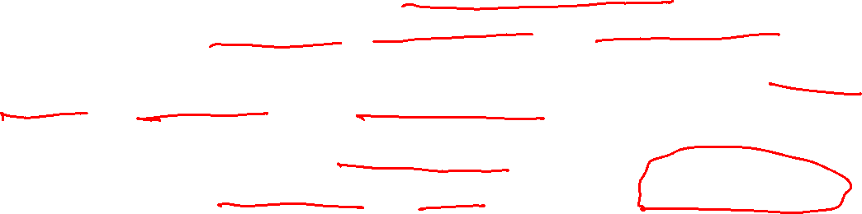
Responsibility
A responsibility is anything that a class knows or does. For example, customers have names, customer numbers, and phone numbers.
These are the things that a customer knows. Customers also order products, cancel orders, and make payments.
These are the things that a customer does.
The things that a class knows and does constitute its responsibilities.
Responsibilities are shown on the left hand column of a CRC card.

Slide 8

Collaborator
Sometimes a class will have a responsibility to fulfill, but will not have enough information to do it.
When this happens it has to collaborate with other classes to get the job done.
For example, an Order object has the responsibility to calculate it’s total. Although it knows about the Order Item objects that are a part of the order, it doesn’t know how many items were ordered (Order Item knows this) nor does it know the price of the item (Inventory Item knows this). To calculate the order total, the Order object collaborates with each Order Item object to calculate its own total, and then adds up all the totals to calculate the overall total.
For each Order Item to calculate its individual total, it has to collaborate with Inventory Item to determine the cost of the ordered item, multiplying it by the number ordered (which it does know). The collaborators of a class are shown in the right-hand column of a CRC card.

Slide 9
CRC Models
A CRC model is a collection of CRC cards that represent whole or part of an application or problem domain.
The most common use for CRC models, the one that this white paper addresses, is to gather and define the user requirements for an object-oriented application.
Example CRC model for a shipping/inventory control system, showing the CRC cards as they would be placed on a desk or work table.
Note the placement of the cards: Cards that collaborate with one another are close to each other, cards that don’t collaborate are not near each other.
CRC models are created by groups of business domain experts, led by a CRC facilitator who is assisted by one or two scribes.
The CRC facilitator is responsible for planning and running the CRC modeling session.

Slide 10
CRC Cards
Step 1: Identify the classes in the problem domain.
Use the problem statement or requirements document to find all of the nouns and verbs in the problem statement.
The nouns represent the object/classes in the system; the verbs may show what their responsibilities are.

Slide 11

CRC Cards
Step 2: Take at least one card per person. Each person should be responsible for at least one class.
Step 3: Add the class name and add responsibilities that are obvious from the requirements. Attributes typically are not added at this time. Add super or subclasses that are obvious.

Slide 12
CRC Cards
Step 4: Walk-through a scenario that represents an important system function in the requirements document.
Decide which class (es) is responsible for this function. The owner of the class then picks up her card and announces that she needs to fulfill this responsibility.
The responsibility may be refined into smaller tasks if possible.
These smaller tasks can be fulfilled by the same object or they can be fulfilled be interacting with other objects.
If no appropriate class (to fulfill this responsibility) exists, you may need to make a class.

Slide 13
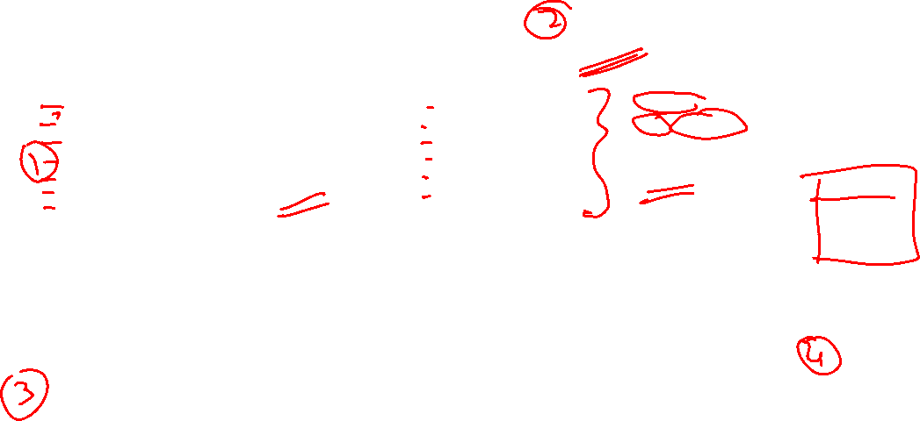

Slide 14
Example-Vending Machine
Let us take an example application and examine the process of identifying the objects/classes and describe their responsibilities using CRC cards.
The example application is a Vending Machine that allows users to buy snack items. In addition, a user can find out the caloric content of her choice.

Slide 15

Example-Vending Machine
Specification :
A Vending machine holds a number of snack items and displays the list of snack items and their prices through an user interface with a display screen and buttons for making selections. In addition, the vending machine has a receptacle for money and an item dispenser.
A user can make a selection and query for the number of calories of a snack item. The calories are displayed on pressing a button. A user can place the money in the receptacle and select an item.

Slide 16
Example-Vending Machine
Let us select the nouns and the verbs in the specification.
Nouns are in blue and the verbs are in green.
A Vending machine holds a number of snack items and displays the list of snack items and their prices through an user interface with a display screen and buttons for making selections. In addition, the vending machine has a receptacle for money and an item dispenser.
A user can make a selection and query for the number of calories of a snack item. The calories are displayed on pressing a button. A user can place the money in the receptacle and select an item.

Slide 17
Example-Vending Machine
Problem-specific classes:
Vending Machine
Snack item
Price
Calories
Selection
User
Presentation-specific classes:
Display screen
Selection Buttons
Item Dispenser
Money receptacle

Slide 18
Example-Vending Machine
Most of the nouns are objects/classes.
Some nouns are attributes of these classes.
The verbs are actions that can be attached to these objects.
In order to focus on the problem-domain objects, let us separate the object/classes into presentation-specific (user-interface related) and problem-specific classes.
We will then select two problem specific classes and write the CRC cards for them.

Slide 19
A CRC card for class SnackItem
Class name: SnackItem
Responsibility
Collaborator
Knows its price and calories

Slide 20
A CRC card for the Vending Machine
Class name: VendingMachine
Responsibility
Collaborator
Maintains a collection of SnackItems.
Allows addition and removal of SnackItems
SnackItem

Slide 21

Showing the Collaboration of a VendingMachine and SnackItem

Slide 22
Exercise Problem Statement
An Automated Teller Machine (ATM) allows bank customers to perform a number of financial transactions: to withdraw and deposit funds to an account, query the balance of any account. The ATM offers an user interface with a display screen, keypad, cash dispenser, deposit slot and a card reader.
Once a customer’s card is verified, the customer can query to see the balance in all her account (s), deposit, withdraw or transfer money from one account into another.
Using Object-Oriented analysis and design techniques, build an object model for the ATM machine.

Slide 23
Exercise
Identify the classes from the problem statement and describe their responsibilities using CRC cards.

